Slide 1
CV Project
Joint Learning of Blind Super-Resolution and Crack Segmentation for Realistic Degraded Images

Slide 2
AIM OF THE PROJECT
INTRODUCTION
Crack segmentation using SR(Super-Resolution) and Binary-segmentation network
The SR network improves the resolution and quality of the image having unknown blurs and then segmentation network will easily identify the cracks in the image
Manual inspection of the infrastructure is difficult
Methods other than crack segmentation (CV) for inspection: Falling weight deflectometer, ground penetrating radar, pavement density profiler etc.
Traditional methods of inspection are labour intensive, time consuming and have geographical limitations.

Slide 3
CRACK SEGMENTATION
PROBLEMS IN REAL-WORLD CRACK SEGMENTATION
Crack segmentation is binary semantic segmentation method in computer vision
Binary(2 classes i.e crack or no-crack) semantic segmentation(pixels are labelled & categorized into the classes without distinguishing within the class)
High class imbalance: The no. of pixels in background(not a crack) is much higher than the no. of pixels in the foreground(crack)
Fine cracks: Cracks are hair like fine, which are sometimes unnoticeable
Low resolution(LR) dataset: The images captured by the inspection camera is very poor and blurred

Slide 4
METHODS USED IN THE PAPER
CSBSR(Crack Segmentation with Blind Super Resolution): The LR images are given as input to SR network which returns the high-resolution image and this image is fed to segmentation network to identify the cracks. The CSSR(Crack Segmentation Super Resolution) assumes a type of blur(gaussian, motion blur etc.) and gives the output segmented image, whereas CSBSR assumes no blur and is more practical method.
CSBSR
Crack Segmentation
LR
+
Blurred Image
Segmented Image
High resolution Image
Boundary Combo(BC) Loss for Segmentation: BC is a loss function(predicted value - actual value) which enhances fine crack and takes care of class imbalance.

Slide 5
METHODS USED IN THE PAPER
Segmentation-Aware SR-Loss Weights: The SR network and CS(crack segmentation) network are trained simultaneously. During training the SR network is not fully optimized and does not completely enhance the cracks.BC loss is used for improving the SR network performance.
Blur Skip for Blur-Reflected Task Learning:The SR network does not completely remove the blur. The SR network identifies the blur and passes this blur information to the segmentation network via skip connection.

Slide 6
IMAGE SEGMENTATION
Image segmentation is a computer vision technique where a digital image is partitioned into discrete group of pixels for extracting certain features.
There are three major category of image segmentation:
1. Semantic segmentation: All pixels of the image are classified into certain class. All pixels belonging to same class are grouped together without internal partition.
2. Instance segmentation: Each instance of the image is given a unique label.
3. Panoptic segmentation: Semantic+instance segmentation. Each pixel is assigned a class label and instance ID.

Slide 7
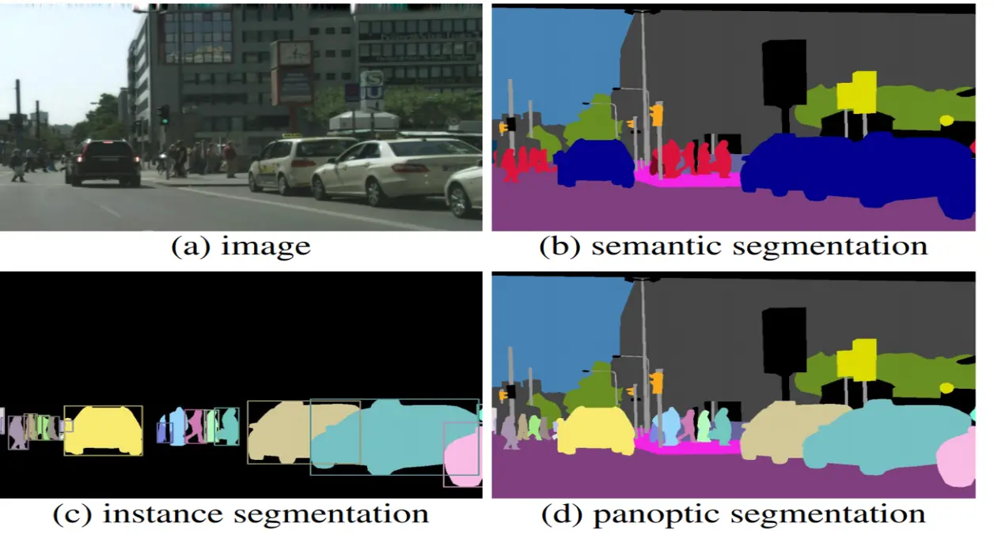
All cars in the semantic image are assigned same label, whereas cars of different shape/size are given different label in instance segmentation. Panoptic segmentation is combination of semantic and instance segmentation.

Slide 8
CLASS IMBALANCE SEGMENTATION
When the background pixels are much higher than the foreground pixels(pixel of interest), then class imbalance problem is faced.
Medical image segmentation faces this issue very often. Segmentation of image to identify tiny tumours, is very difficult due to class imbalance.
Methods like weighted loss function, focal loss, re-sampling and hard mining is used for dealing with class imbalance.
In weighted loss function method the weight of the rare pixels is increased so that they can be segmented. In focal loss the focus/priority is given more to these rare pixels.
In re-sampling the rare pixels are oversampled and background pixels are undersampled.
Loss function is a error function (predicted value - ground truth) of any ML model

Slide 9
CRACK SEGMENTATION
The crack segmentation has 2 major issue: class imbalance and fine crack segmentation.
The class imbalance is tackled by methods like weighted loss function, re-sampling, hard mining etc.
The fine crack segmentation is tackled by distance based approach, where the distance between predicted crack boundary and actual crack boundary is reduced(error is reduced).
As the distance reduces, the model becomes more accurate.
We can even use neural network based approach (U-net) for segmenting crack boundary layer by layer.

Slide 10
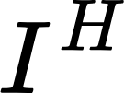

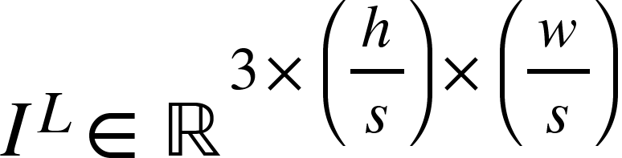

NON-BLIND SR (Super-Resolution)
Super resolution is a method in CV where a high resolution(HR) image is reconstructed from a low resolution(LR) image.
In Non-blind SR, we assume the image degradation process and it is fixed. We assume a certain blur(Gaussian blur, motion blur etc.) and apply SR algorithm according to the degradation process.
Mathematical model of SR is:
Super-Resolution
$I^{H}=HR Image$ h = Height of the Image s = Down-sampling factor
$I^{L}=LR Image$ w = Width of the Image

Slide 11
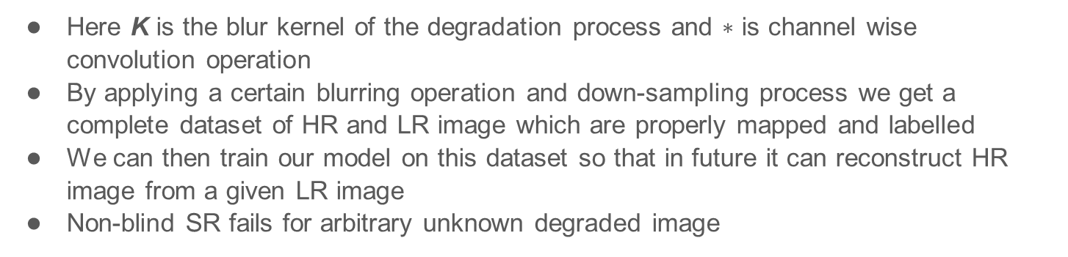

The dimension of the image is 3 x h x w (3 channels and each channel is a h x w 2-D matrix)
Under down-sampling the image size is reduced by a factor ‘s’
Ex: 1024x1024 image is down sampled to 256x256 (s=4)
$I^{L}$=($I^{H}∗$ K)$↓s$
Here K is the blur kernel of the degradation process and $∗$ is channel wise convolution operation
By applying a certain blurring operation and down-sampling process we get a complete dataset of HR and LR image which are properly mapped and labelled
We can then train our model on this dataset so that in future it can reconstruct HR image from a given LR image
Non-blind SR fails for arbitrary unknown degraded image

Slide 12

BLIND SR
In blind SR the HR image is generated without knowing or assuming the image degradation process.
Blind SR reconstructs the HR image from an input LR image without knowing the blur effect and learn from it to
$I^{L}$=($I^{H}∗$ K)$↓s$
In blind SR the kernel K is unknown.
The Blind SR neural network is trained on many images having various kind of blur(motion blur, gaussian blur, defocus blur etc.), the model learns from this data and eventually become capable of deblurring an image with unknown blur.
Sometimes Deblurring operation is performed on the image before feeding it to SR network. The deblurring network estimates the blur and feeds this information along with the LR image to the SR network.

Slide 13
JOINT LEARNING OF SR & CRACK SEGMENTATION
Earlier SR network was trained separately for just producing HR images from LR images for general purpose.
In joint learning the SR network and crack segmentation are trained together so that SR can optimize itself for crack segmentation specifically.
Training SR network separately will only improve image quality not segmentation quality.
In CSBSR, the SR network and crack segmentation network are trained together and integrated into one model. The blind-SR handles the unknown real-world blur.
In DSRL(Dual SR Learning) the SR network and crack segmentation network is connected together by a feature extractor but they split into different branches and hence are not optimised as CSBSR.

Slide 14
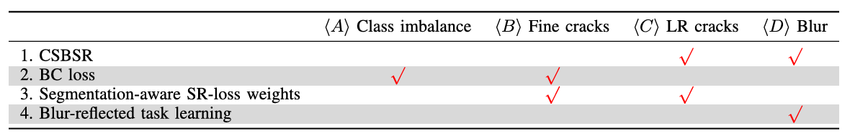
JOINT LEARNING OF BSR & CRACK SEGMENTATION
Loss function(BC loss) helps to detect the fine cracks during class imbalance.
Loss weighting is used for making the BSR network better.
Crack segmentation and SR network are jointly trained and connected by a feedback so that CS can optimize SR for crack detection and segmentation.

Slide 15


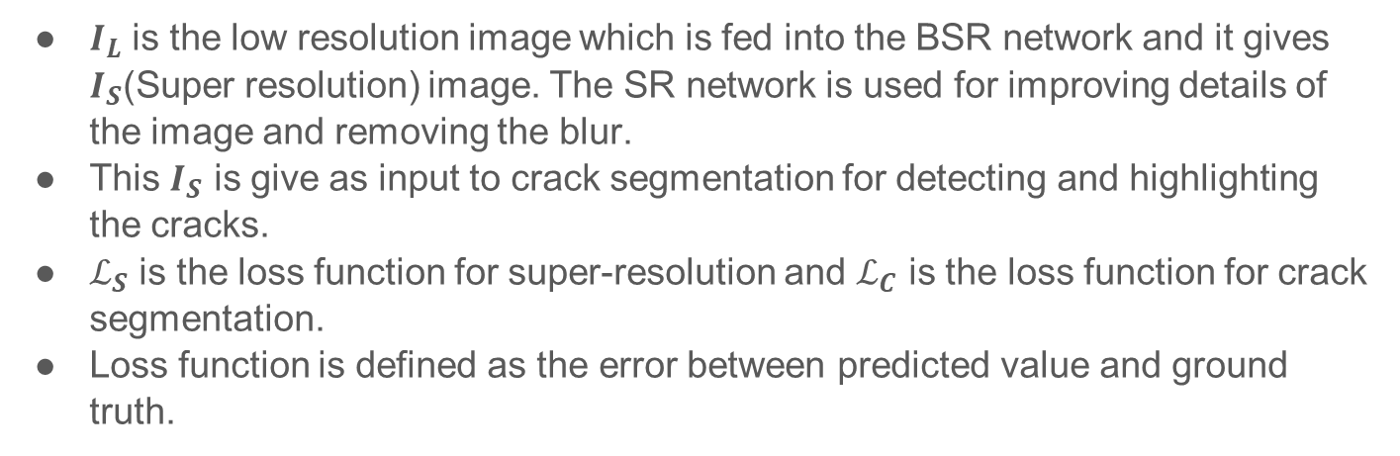



JOINT LEARNING
$$I_{S}$$
$$I_{L}$$
Super Resolution
S
Crack Segmentation
C
$$I_{C}$$
$$ℒ_{S}$$
$$ℒ_{C}$$
$I_{L}$ is the low resolution image which is fed into the BSR network and it gives $I_{S}$(Super resolution) image. The SR network is used for improving details of the image and removing the blur.
This $I_{S}$ is give as input to crack segmentation for detecting and highlighting the cracks.
$ℒ_{S}$ is the loss function for super-resolution and $ℒ_{C}$ is the loss function for crack segmentation.
Loss function is defined as the error between predicted value and ground truth.

Slide 16

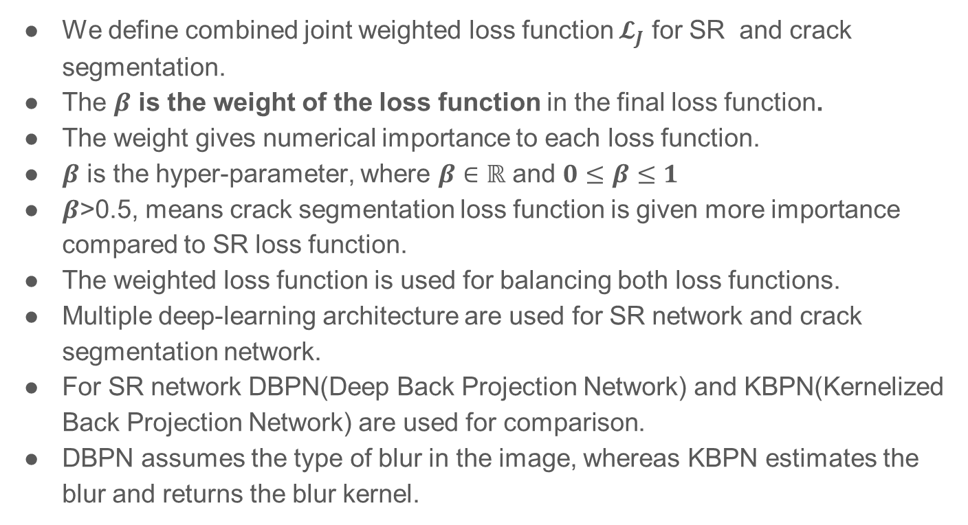
$𝓛_{J}$= ${(1−β)𝓛}_{S}$ + $β𝓛_{C}$
We define combined joint weighted loss function $𝓛_{J}$ for SR and crack segmentation.
The $β$ is the weight of the loss function in the final loss function.
The weight gives numerical importance to each loss function.
$β$ is the hyper-parameter, where $β∈ℝ$ and $0≤β≤1$
$β$>0.5, means crack segmentation loss function is given more importance compared to SR loss function.
The weighted loss function is used for balancing both loss functions.
Multiple deep-learning architecture are used for SR network and crack segmentation network.
For SR network DBPN(Deep Back Projection Network) and KBPN(Kernelized Back Projection Network) are used for comparison.
DBPN assumes the type of blur in the image, whereas KBPN estimates the blur and returns the blur kernel.

Slide 17
For crack segmentation(C) we implement U-net, PSPnet(Pyramid Scene Parsing network), Crack Former, HRnet+OCR(High Resolution network with Object Contextual Representation).
CSBSR is built using multiple networks to make it versatile in real world scenarios.
U-net is used for image segmentation using U-shaped architecture (preserves fine details using skip connection).
Skip connection is type of feedback connection which bypasses certain layers of deep-learning and helps in the reconstruction of image by providing fine details.
PSPnet uses multi-scale feature extraction for image segmentation.
Crack former a transformer based image segmentation network.
A transformer is a deep-learning model which processes all the input parallelly. This reduces the computation time.

Slide 18
BC LOSS
Boundary Combo loss handles the class imbalance issue in the crack segmentation.
It focuses on locally fine segmentation, where it highlights the most fine and small cracks.
It also focuses on globally robust segmentation, where it maintains the stable and balanced segmentation throughout the image.
BC loss combines 3 loss functions for fine crack detection:
Boundary loss: This loss function ensure that the boundary of fine cracks is highlighted properly. Ensures Crack contours are well defined.
GDice loss: Ensures the cracks are segmented properly.
Weighted Cross Entropy: Gives more weight to fine crack pixels compared to the background pixels.

Slide 19

$𝓛_{B}$ is boundary loss, $𝓛_{D}$ is GDice loss and $𝓛_{WCE}$ is weighted cross entropy loss.
$α$, $γ$ are the weights of the loss functions, where $0≤α≤1$ and $0≤γ≤1$

Slide 20
PROJECT OVERVIEW
FFUSION
Binary segmented
Image
LR Image
HR Image
Crack Segmentation Network
SR Network
FUSION
Blur Kernel K
We are only going to implement the CS network.
For BC loss refer:
H. Kervadec, J. Bouchtiba, C. Desrosiers, E. Granger, J. Dolz, and I. Ben Ayed, “Boundary loss for highly unbalanced segmentation,” Med. Image Anal., vol. 67, Jan. 2021, Art. no. 101851
H. Kervadec, J. Bouchtiba, C. Desrosiers, E. Granger, J. Dolz, and

Slide 21
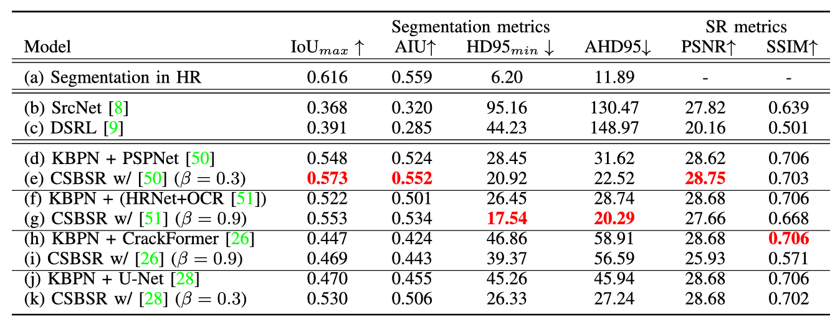
We are going to use PSPnet(Pyramid Scene Parsing network) architecture for CS network, because it has Max IoU and AIU(Average IoU).
PSPnet uses ResNet18 pretrained on ImageNet as encoder. PPM(Pyramid Pooling Module) comes after encoder.

Slide 22
What is PSPnet ?
PSPnet = Pyramid Scene Parsing network
It is a semantic segmentation deep learning network, that labels every pixel of the image as crack or no-crack(background)
PSPnet uses ResNet or VGG for feature extraction from the image
Pooling = shrinking the feature map to keep the most relevant features/information only.
PSPnet utilizes “Pyramid Pooling”, where it zooms the image at different scale (global scale, local scale) and then applies the pooling
Finally the pooling layers at different scales are concatenated to form the mask
At the end upsampling is done to give a visible segmented image.

Slide 23
How training will be done ?
Encoder(feature extractor) = Pre-trained ResNet-18 or VGG-16 on Imagenet
Pyramid pooling for multi-scale feature extraction
Decoder = upsampling
Binary Cross Entropy Loss (BCE Loss) = For estimating error between ground truth mask and predicted mask
Optimizer = Helps the model to reduce the error based on the loss function
- Common optimizer = Adam
Train
Validate
Evaluate metrices

